Slide 1
Georgia
By: Josie Fernandez & Kevin Rincon

Slide 2
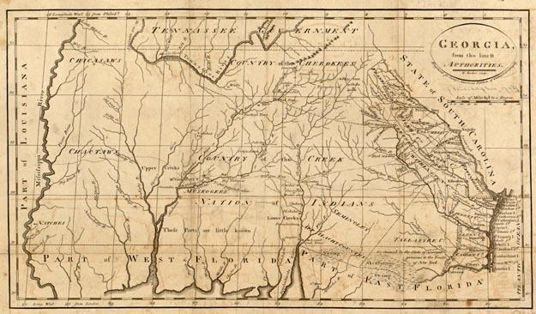
Founding
Founded:1733
Founded by: James Oglethorpe
Reason for colonization: for people who want to start over

Slide 3
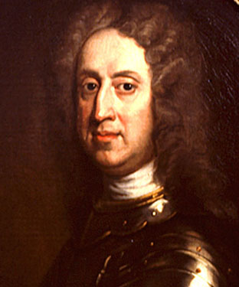
Important People
James Oglethorpe
First person to name Georgia after King George

Slide 4
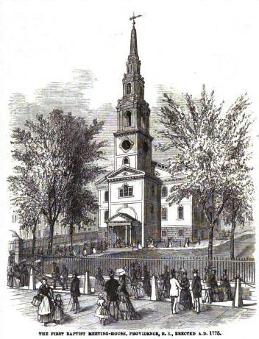
Religion
Not dominated by a specific religion which gave way to religious freedom

Slide 5
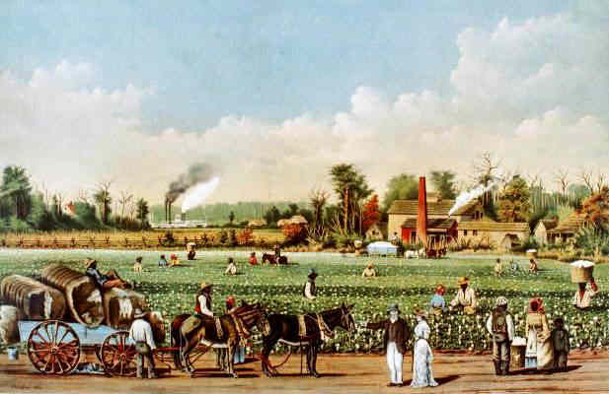
Economy
Exported tobacco , cotton, corn, and vegetables
Crops were traded for things that couldn’t produce on the plantations including shoes, lace, thread, and farm tools

Slide 6
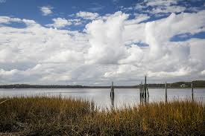
Natural Resources
Hilly coastal provided plenty of forest
Warm weather made it easy to grow plants through out the year

Slide 7
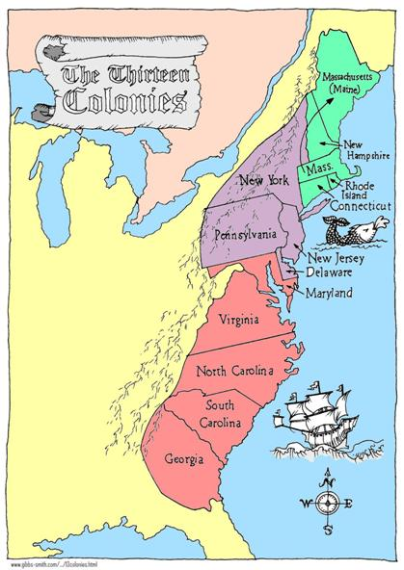
Interesting Facts
Oglethorpe didn’t allow liquor because he thought it made colonist lazy
Last colony founded 50 years after the other twelve

Slide 8
Questions
Who was Georgia founded by?
Why was Georgia founded?
Why didn’t Oglethorpe allow liquor?
What was Georgia named after

Slide 9
Bibliography
http://www.google.com/imgres?q=georgia+colony&hl=en&safe=active&sa=X&tbo=d&rls=com.microsoft:en-us:IE-SearchBox&biw=1440&bih=719&tbm=isch&tbnid=2aYdW-DFr3-KRM:&imgrefurl=http://www.sonofthesouth.net/revolutionary-war/colonies/georgia-colony.htm&docid=9PqcKrCaUfOIuM&imgurl=http://www.sonofthesouth.net/revolutionary-war/maps/georgia-map-625.jpg&w=625&h=366&ei=Z-4TUZ2mLoaIiALbgYGIBQ&zoom=1&iact=hc&vpx=506&vpy=133&dur=57375&hovh=172&hovw=294&tx=122&ty=107&sig=10277117002038679943&page=1&tbnh=133&tbnw=227&start=0&ndsp=29&ved=1t:429,r:3,s:0,i:92&surl=1
http://www.google.com/imgres?q=georgia+church+colony&hl=en&safe=active&tbo=d&rls=com.microsoft:en-us:IE-SearchBox&biw=1440&bih=719&tbm=isch&tbnid=ymJqkHdBWC6OnM:&imgrefurl=http://ushistoryclassroom.blogspot.com/2011/08/nwc-colonial-regional-development.html&docid=5UChicho8zt-mM&imgurl=http://2.bp.blogspot.com/-Ib54SAgjDoY/TlrPYH01shI/AAAAAAAAC2A/wyRdG6oxpJ4/s1600/First_Baptist_Church_in_America_in_RI.jpg&w=352&h=461&ei=wfETUfLXAurJiwKulIHwBQ&zoom=1&iact=hc&vpx=2&vpy=243&dur=2766&hovh=257&hovw=196&tx=80&ty=120&sig=102771517002038679943&page=1&tbnh=148&tbnw=113&start=0&ndsp=33&ved=1t:429,r:8,s:0,i:104&surl=1
http://www.google.com/imgres?q=james+oglethorpe&hl=en&safe=active&sa=X&tbo=d&rls=com.microsoft:en-us:IE-SearchBox&biw=1440&bih=719&tbm=isch&tbnid=CZ0DVO7oAfvk2M:&imgrefurl=http://georgiainfo.galileo.usg.edu/ogle1.htm&docid=ObZRg4e1arWENM&imgurl=http://georgiainfo.galileo.usg.edu/oval2.jpg&w=312&h=375&ei=0PATUYm8O-iAiwKK4oDABw&zoom=1&iact=hc&vpx=845&vpy=100&dur=547&hovh=246&hovw=205&tx=116&ty=172&sig=102771517002038679943&page=1&tbnh=142&tbnw=133&start=0&ndsp=40&ved=1t:429,r:6,s:0,i:101&surl=1
http://www.google.com/imgres?q=colony+of+georgia+economy&hl=en&safe=active&sa=X&tbo=d&rls=com.microsoft:en-us:IE-SearchBox&biw=1440&bih=719&tbm=isch&tbnid=diIR_CFCmubdeM:&imgrefurl=http://www.landofthebrave.info/georgia-colony.htm&docid=2QirxBgnre7GBM&imgurl=http://www.landofthebrave.info/images/cotton-plantation-southern-colonies.jpg&w=617&h=400&ei=TfMTUfCrL-
qIiwLj7IGgBQ&zoom=1&iact=hc&vpx=2&vpy=128&dur=1375&hovh=181&hovw=279&tx=198&ty=100&sig=102771517002038679943&page=1&tbnh=133&tbnw=216&start=0&ndsp=31&ved=1t:429,r:0,s:0,i:83&surl=1http://www.google.com/imgres?q=http://www.google.com/imgres?q=thirteen+colonies&start=99&um=1&hl=en&safe=active&sa=N&tbo=d&rls=com.microsoft:en-us:IE-SearchBox&biw=1366&bih=587&tbm=isch&tbnid=Egd-
9iQPmI7RcM:&imgrefurl=http://mrjohnsonssclasses.wikispaces.com/The%2BRise%2Bof%2Bthe%2B13%2BColonies&docid=yz8ol2dZuPk9CM&imgurl=http://mrjohnsonssclasses.wikispaces.com/file/view/13_colonies_color_map.jpg/168785149/13_colonies_color_map.jpg&w=419&h=592&ei=YEIVUfSfO6btiwLkiYHQAg&zoom=1&iact=hc&vpx=355&vpy=115&dur=5188&hovh=267&hovw=189&tx=131&ty=148&sig=105711536406367674781&page=4&tbnh=148&tbnw=104&ndsp=36&ved=1t:429,r:2,s:100,i:10&surl=1

