Slide 1
Massachusetts colony
By: Kaja Lagunas
and Chase Nunez

Slide 2
The beginning
The founder: John Winthrop
Founded: 1630
Reason: For the Puritans beliefs

Slide 3
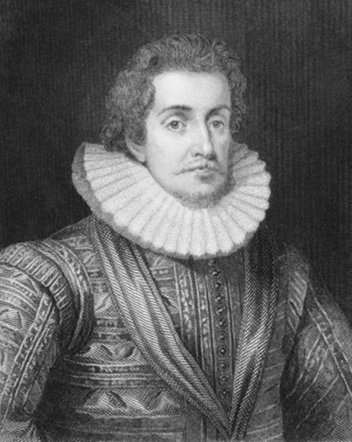
Important people
John Winthrop founder of Massachusetts
King James the I gave a profit to the Massachusetts bay company
Solomon Stoddard created their culture

Slide 4
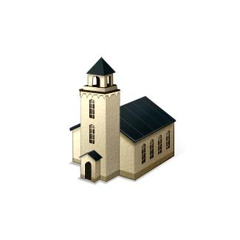
Religion
They believed in following the bible
For example: before making a decision they would ask their self what would god do?
They did not learn or believe any other religion

Slide 5
Geography/ climate
Mountains, trees, river, but poor soil rocky soil that was difficult to farm
Mild short summers long cold winters

Slide 6
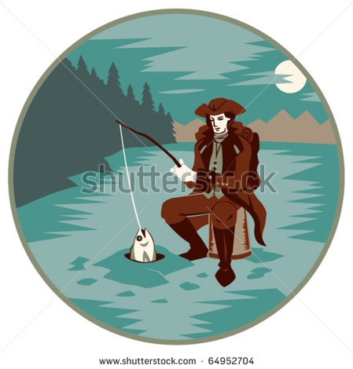
Economy
Their major industries: fishing, lumbering, ship building
Caught cod fish and sold it to traders and became very wealthy
Traded crops

Slide 7
Interesting facts
Massachusetts was named by natives
It means (at the grassy hills)

Slide 8
Questions
Who Was the founder of Massachusetts?
Who named Massachusetts and what does It mean?
What did king james the 1 do?
What was one of the main industries

Slide 9
Bibliography
http://www.history-map.com/picture/004/Massachusetts-Colony-Map.htm
http://www.usahistory.info/New-England/Massachusetts.html
http://www.broadstreetumc.net/the-king-james-version-is-turning-400
http://www.permamatrix.com/abundant-crops/
http://www.sonofthesouth.net/revolutionary-war/colonies/life-colonies.htm

