Slide 1
New Hampshire colony
By: Jenna & Lauren

Slide 2
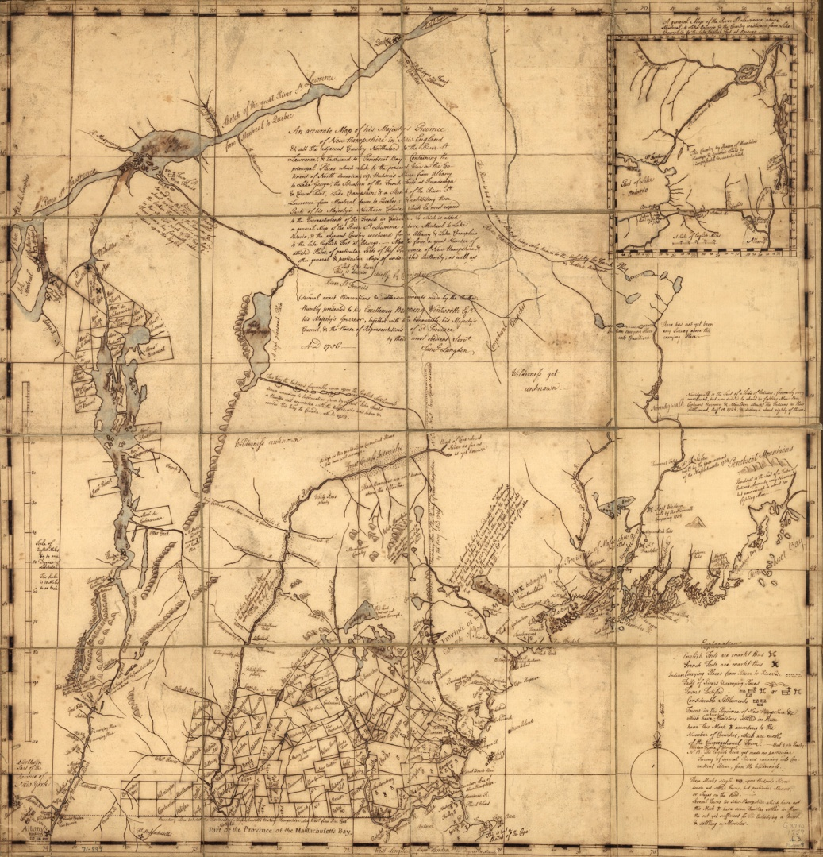
Founding
Founded in 1638
Founded by John Wheelwright
Hoped to make money

Slide 3
Important people
John Wheelwright founded New Hampshire
He was sent away for disagreeing with the Puritans
He bought a village from the Pennacook Indians

Slide 4
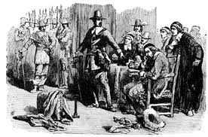
Religion
No religious freedom
Puritans ran the government
Anyone who disagreed with the puritans way of life was punished

Slide 5
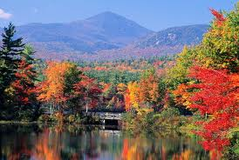
Economy and Climate
Exported fish, fur, and lumber
Agricultural exported cattle
Cold weather and coastal waters
Shipping was a huge business

Slide 6
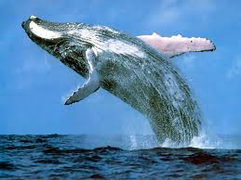
Natural Resources
Fish , whales and forest
Different trees birch, cedar, maple, and pine

Slide 7
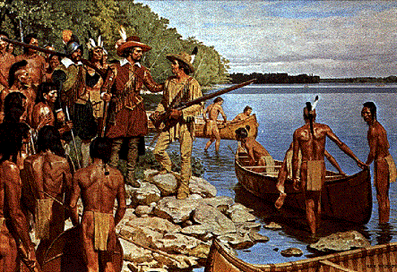
Interesting facts
12,000 natives spoke algonquion inhabited New Hampshire before Europeans
Pennacook taught things to colonists like keeping meat fresh by covering it with snow

Slide 8
WHAT DID YOU LEARN?
Who was the founder ?
Why was New Hampshire founded?
When was New Hampshire founded?

Slide 9
Bibliography
http://www.google.com/search?q=john+wheelwright&hl=en&safe=active&tbo=d&source=lnms&tbm=isch&sa=X&ei=UfsbUaX-CsjxigLZw4CgAw&ved=0CAoQ_AUoAQ&biw=1440&bih=719&surl=1
http://www.google.com/search?q=john+wheelwright&hl=en&safe=active&tbo=d&source=lnms&tbm=isch&sa=X&ei=UfsbUaX-CsjxigLZw4CgAw&ved=0CAoQ_AUoAQ&biw=1440&bih=719&surl=1#hl=en&safe=active&tbo=d&tbm=isch&sa=1&q=puritans&oq=puritans&gs_l=img.1.0.0l10.52485.63125.0.64906.15.15.0.0.0.1.250.2139.2j10j2.14.0.crnk_timediscounta..0.0...1.1.3.img.hLK71wqBeVU&bav=on.2,or.r_gc.r_pw.r_qf.&bvm=bv.42452523,d.cGE&fp=c49db0b4efaa700b&biw=1440&bih=719
http://www.sonofthesouth.net/revolutionary-war/maps/new-hampshire-map.htm
http://www.google.com/search?q=algonquian+indians&hl=en&safe=active&tbo=d&source=lnms&tbm=isch&sa=X&ei=tI0eUf7HPKPgiAKSuoCQBg&sqi=2&ved=0CAcQ_AUoAQ&biw=1280&bih=843&surl=1
http://www.google.com/search?q=algonquian+indians&hl=en&safe=active&tbo=d&source=lnms&tbm=isch&sa=X&ei=tI0eUf7HPKPgiAKSuoCQBg&sqi=2&ved=0CAcQ_AUoAQ&biw=1280&bih=843&surl=1#hl=en&safe=active&tbo=d&tbm=isch&sa=1&q=whales&oq=whales&gs_l=img.1.0.0l10.91563.100547.0.101891.16.13.0.0.0.4.172.1472.5j7.12.0...0.0...1c.1.3.img.q52sYOColDs&bav=on.2,or.r_gc.r_pw.r_qf.&bvm=bv.42553238,d.cGE&fp=11b420734e603922&biw=1280&bih=843
http://www.google.com/search?q=algonquian+indians&hl=en&safe=active&tbo=d&source=lnms&tbm=isch&sa=X&ei=tI0eUf7HPKPgiAKSuoCQBg&sqi=2&ved=0CAcQ_AUoAQ&biw=1280&bih=843&surl=1#hl=en&safe=active&tbo=d&tbm=isch&sa=1&q=lake+and+trees+in+new+hampshire&oq=lake+and+trees+in+new+hampshire&gs_l=img.12...56297.77219.2.78563.38.34.2.2.2.0.156.3136.29j4.33.0...0.0...1c.1.3.img.lz-GJpFo3rE&bav=on.2,or.r_gc.r_pw.r_qf.&bvm=bv.42553238,d.cGE&fp=11b420734e603922&biw=1280&bih=843

