Slide 1
North Carolina
By Zack Howard and Nathan Archer

Slide 2
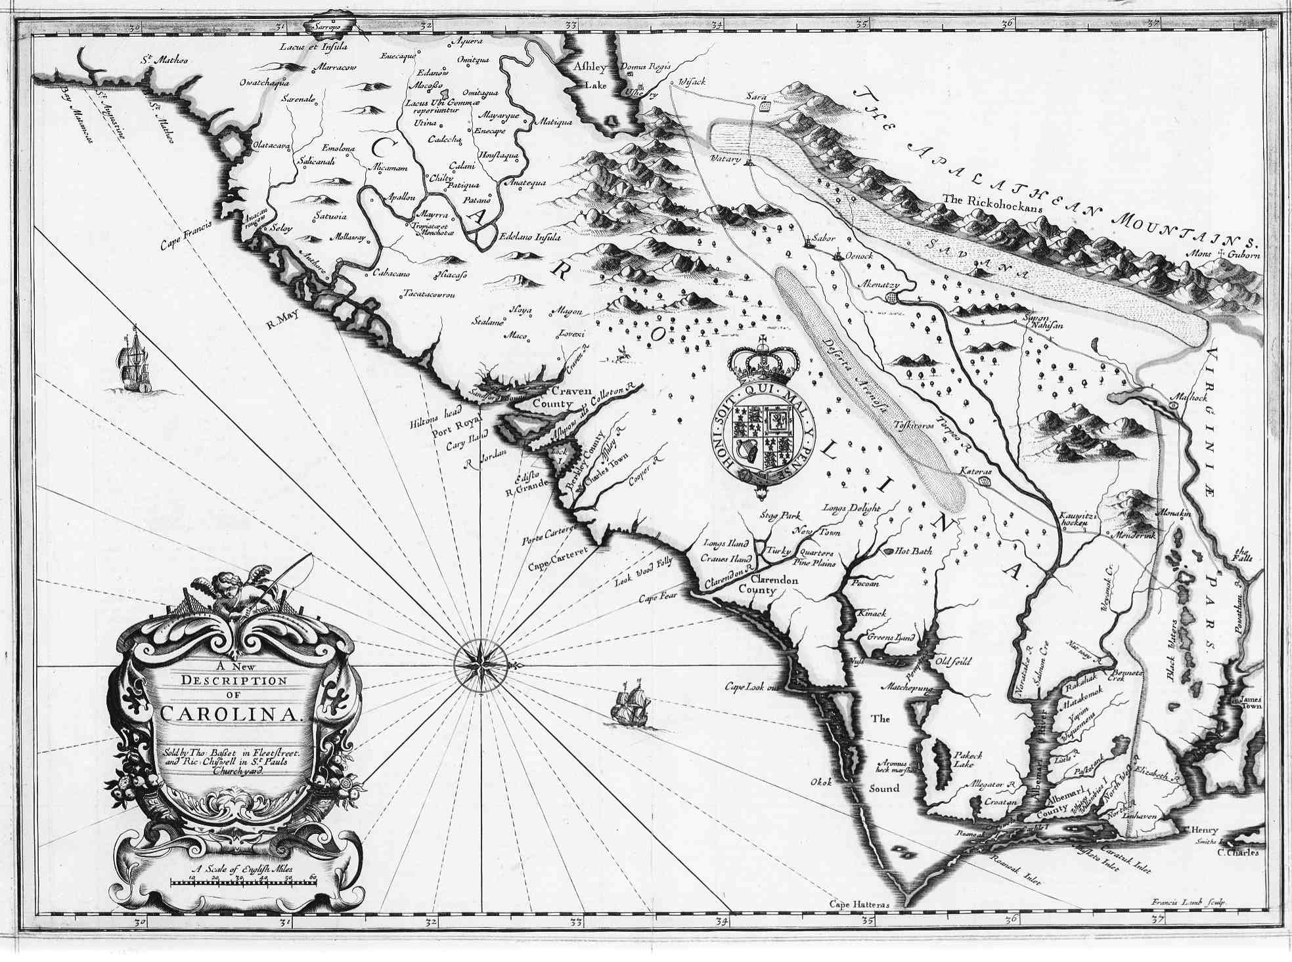
Founded
Founded in:1653
Founded by :Virginia colonists
Searched for farmland and freedom of religion

Slide 3
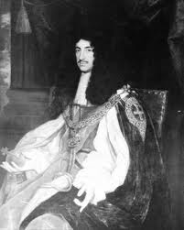
Important People
There were 8 men , Lord Proprietors, that divided Carolina in 3
They called part of the land Carolina
Nathaniel Batts built the first house in North Carolina

Slide 4
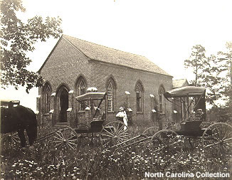
Religion
King Charles II wanted people to come to North Carolina so he made a deal
If you stayed there you would get free taxes for a year
Colonists had to have religious freedom

Slide 5
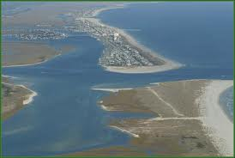
Geography & Climate
Has coastal plains, plateau, and mountain ranges
Not hard to survive winter, because it is hot
Lots of drought

Slide 6
Natural Resources & Economy
Natural Resources
Economy
Fish
Forests
Fertile soil
Farming and plantations were important
They farmed tobacco, cotton, corn, vegetables, grain, fruit, and live stock
They made ships to ship the resources

Slide 7
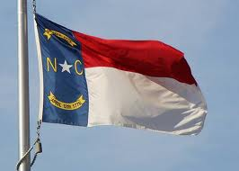
Interesting Facts
Population grew from 30,000 to 110,000 people.

Slide 8
Questions
Who was the founder of North Carolina?
Why was North Carolina founded?
What did the population grow to?
What was King Charles deal about religion?

Slide 9
Bibliography
http://www.motherearthnews.com/Real-Food/Growing-Wheat-Types-Of-Wheat.aspx
http://www.lib.unc.edu/ncc/ref/study/religion.html
http://www.northcarolinahistory.org/commentary/154/entry
http://www.travels.com/destinations/usa/interesting-facts-north-carolina/
http://www.news.appstate.edu/2007/06/21/nc-coastline/

