Slide 1
Rhode Island
By: Christian Mejia & Justin Peoples

Slide 2
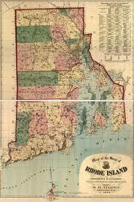
Founding
Founded by Roger Williams 1636
Founded for free religion

Slide 3
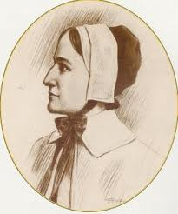
Important People
Anne Hutchinson
Banned from Massachusetts
Helped spread religious freedom
Was hospitable to the sick

Slide 4
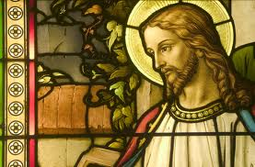
Religion
Free religion colony
Former Puritans came for religious freedom
Lots of different religion in the colony

Slide 5
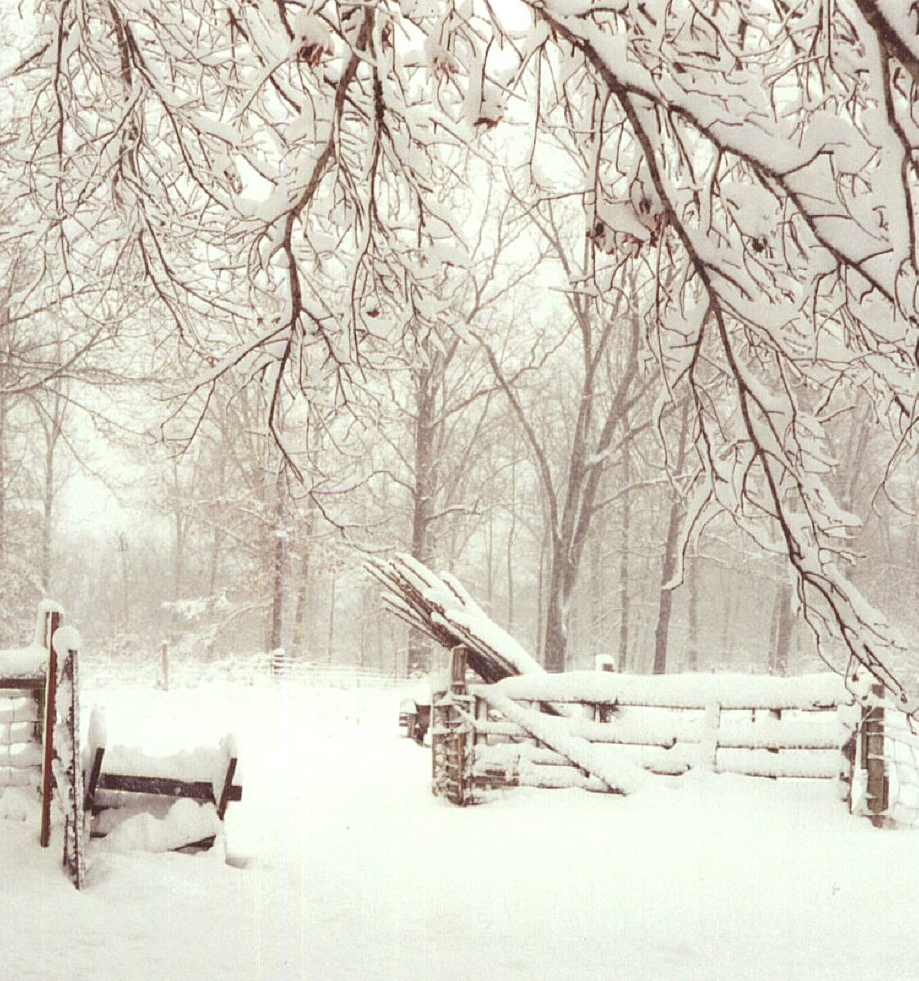
Economy, Geography, & Climate
Economy: fished, whaled, traded fur, sugar industry, & they were ship makers
Geography: coastal colony, rocky soil, & lush forests
Climate: mild short summers, long cold winters

Slide 6
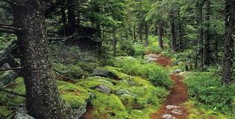
Natural Resources
Lumber
Fish, whales, water
Sugar

Slide 7
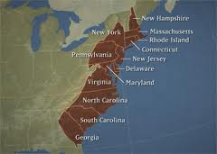
Interesting Facts
Smallest colony
Named after the original Dutch named Red-Island

Slide 8
Questions
Chris’s: what year was Rhode Island founded?
Justin’s: who founded Rhode Island

Slide 9
Bibliography
americaslibrary.gov
nps.gov
oakdalepress.com
contraception.about.com
nature.org
awesomeamerica.com

