Slide 1
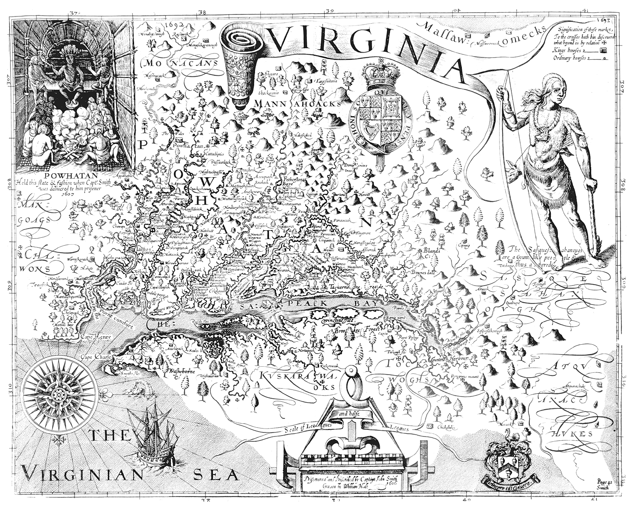
The amazing Virginia
By: Dylan turner
Kayleena chavquez

Slide 2
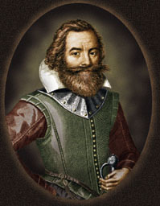
founded
John smith
1607
They (as in john smith and others) were sick of Spain getting all the money and fortune

Slide 3
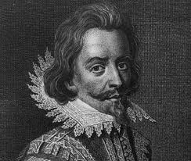
Important people
Nathaniel Bacon
Burned James town
John smith
Founded and saved Jamestown
John Rolfe
Helped the colony survive

Slide 4
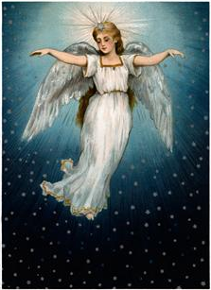
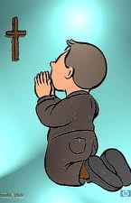
Religion
Religious freedom
Baptist, angelica, and others

Slide 5
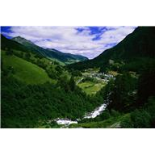
economy
Natural recourses & economy
Trees
Tobacco
plantations
Climate and geography
Warm
Rivers
Mountain
Lakes
Coastal plains
valleys

Slide 6
Important facts
1700’s largest colony
Food
Nathaniel bacon
Diseases spread
Bad location
Starving time

Slide 7
Questions?
Do you think that nathanial bacon was more of a bad or a good guy? Explain.
Who is John Smith?
Why did the powhatan attack the colonists
What do think it was like back then in Virginia hard or easy?

Slide 8
bibliography
\www.landhttp://apva.org/rediscovery/page.php?page_id=25
ofthebrave.info/virginia-colony.htm

