Slide 1
The Virginia Colony
By: Logan Pimley.

Slide 2
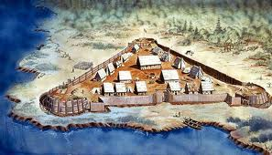
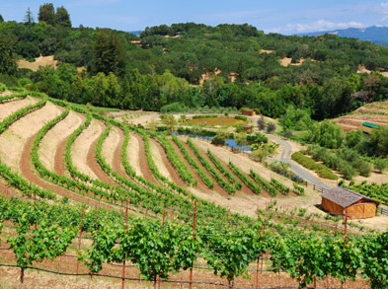
Founding Virginia
Founded in 1607Founder is John Smith and John Rolfe
Reason for colonization is the fish , forest or timber, and farming

Slide 3
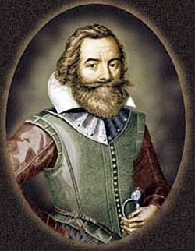
Important People
John Smith was in control of building James Town
In the starving time John decided to trade with native americans
They where about to run out off food then John made the rule “You don’t work you don’t eat”

Slide 4
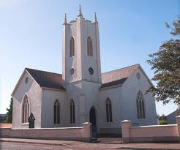
Religion/Basic Beliefs
By the 1750,many coloniest didn’t follow the church of England
The seetlers wanted to belief there own beliefs
Some off the seetlers teached some of these religion

Slide 5
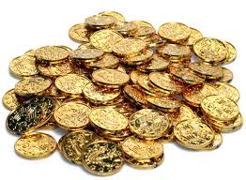
Economy
The major industrity is on plantations or agriculture ( tabcoo,corn,wheat)
Virigina had valleys and mountains perfect for planting plants

Slide 6
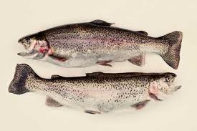
Natural Resources
Some off the very reasorces are fish ,timber or forestand agriculture
Farming was one off the very reasorces

Slide 7
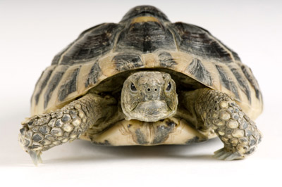
Interesting Facts
The population was the 1607 is 104 to the 1775 is 500000
In the early years people could barrly eat food so they ate what they could find fish,turtles,and corn
Boys learned more that girls back then in school

Slide 8
Biligophy
Pitcures are all off of the website are www.google.com

Slide 9
To See If you learned?
What was John Smith in control off James Town?
What was one off the three things that they made money on besides wheat and corn?

Slide 10
The answers to the Questions?
The first is to question one is the building
The answer to question two is tabcco

