Slide 1
Massachusetts the Third Colony
By: Madison Howe and Nicholas Rinehart

Slide 2
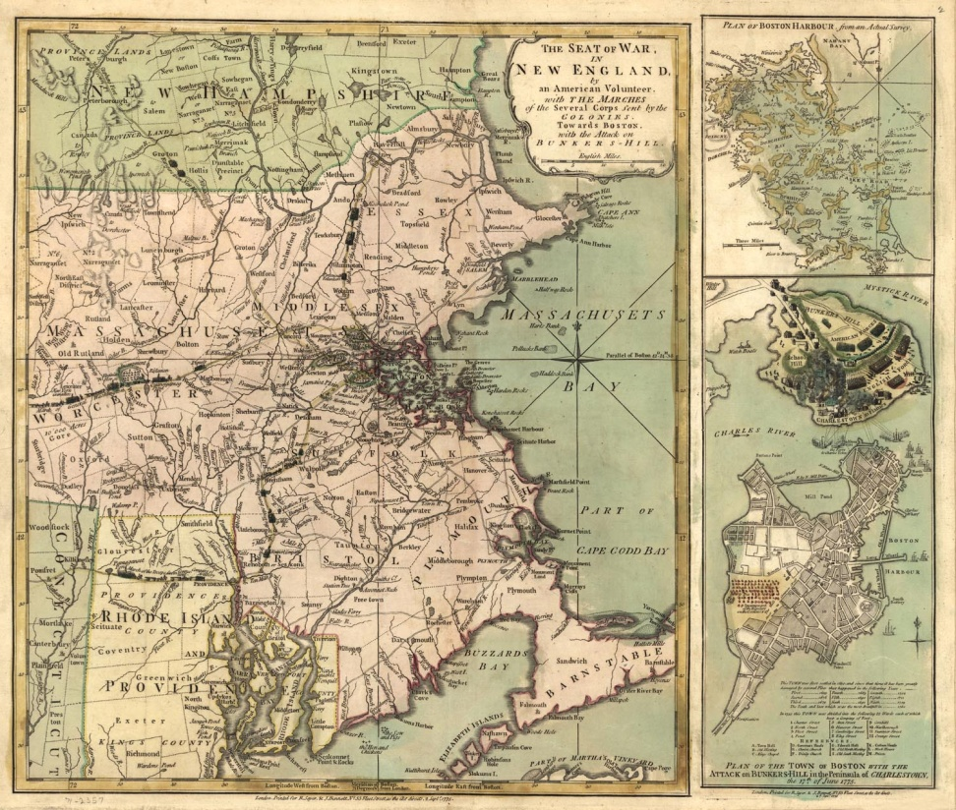
The Beginning
Founded in: 1630
Founded by: John Winthrop
Reason why: Wanted to purify their religion

Slide 3
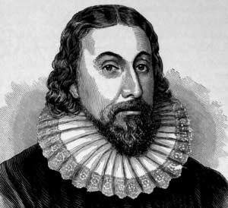
Important People
John Winthrop: English Puritan leader and was governor of Massachusetts Bay Colony

Slide 4
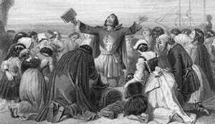
Religion
They’re Puritans
Taught to live by the bible

Slide 5
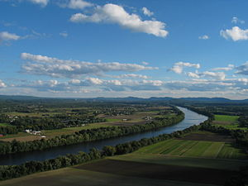
Geography and Climate
Climate: Mild, short summers and long, cold winters
Geography: Mountains, trees, rivers, and poor, rocky soil

Slide 6
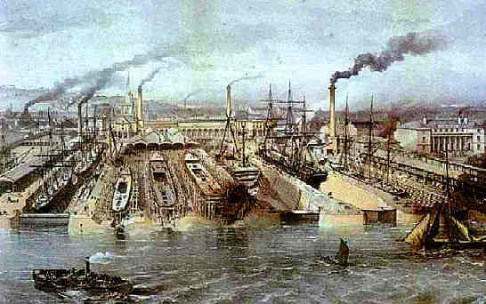
Economy
Farmed corn, pumpkins, rye, squash, and beans
Concentrated in manufacture
Focused on town life and industries

Slide 7
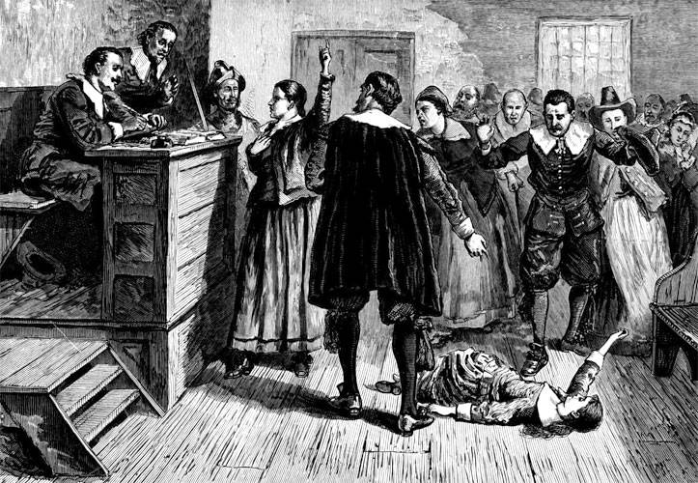
Interesting Facts
Salem Witch Trials
People believed that black cat blood could cure sickness
Children had very few toys
Enjoyed playing sports and games with siblings

Slide 8
What did you learn?
Who was the founder of Massachusetts?
What was the reason behind founding Massachusetts?
What were the people of Massachusetts’ religion.
Was Massachusetts great place for framing?

Slide 9
Bibliography
Websites
http://www.pbs.org/godinamerica/people/john-winthrop.html
http://www.sonofthesouth.net/revolutionary-war/maps/massachusetts-map.htm
http://hot-dogma.com/2012/12/31/gods-controversy-with-new-england/puritans/
http://www.landofthebrave.info/new-england-colonies.htm
http://en.wikipedia.org/wiki/Salem_witch_trials
http://www.newworldencyclopedia.org/entry/Massachusetts

