Slide 1
New Hampshire
By Julio and Jordan

Slide 2
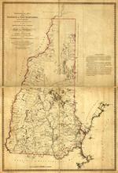
1623
Found in 1623
Founded by John Mason
Freedom from James town

Slide 3
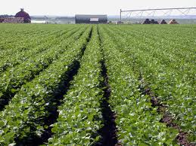
Important people
Dave Thomas
Received 6,000 acres of land
Planted grapes and traded with the natives

Slide 4
Religion beliefs
Religion freedom
Every one had to be able to read the bible

Slide 5
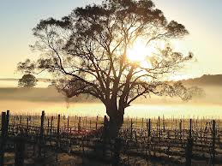
economy
Mountains , trees, rivers, but poor rocky soil
Mild short summers and long cold winters

Slide 6
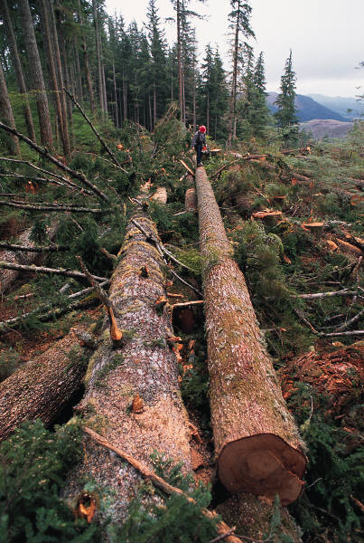
Natural resources
Lumber, pine, maple, cedar, and birch trees
Fishing, farming, and fur trading

Slide 7
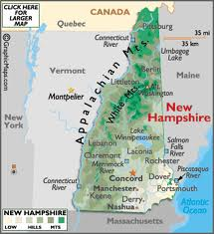
Interesting facts
Was found as a business enter price
Had to share colony with Massachusetts
Businesses were based on its natural resources

Slide 8
Web sites
http://www.wisegeek.com/what-are-the-languages-of-biblical-times.htm#slideshow
http://nofallingsky.com/mother-earth/community-farming/
Clip art
http://www.wisegeek.com/what-are-the-languages-of-biblical-times.htm#slideshow
http://www.worldatlas.com/webimage/countrys/namerica/usstates/nh.htm

Slide 9
Questions
Who found New Hampshire?
When was it found?
What were their religion beliefs?
What was their reason for colonization?

