Slide 1
New Hampshire
By Blair Carter & Eli Bigelow

Slide 2
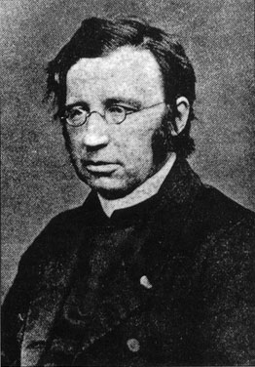
Founded
Year Founded-1623
Founder-John Mason
Colonization Reasons-
Fish
Trade
Religious Freedom

Slide 3
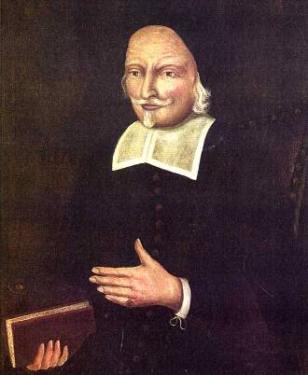
Important People
John Mason-Founded
John Wheelwright-Established first settlement

Slide 4
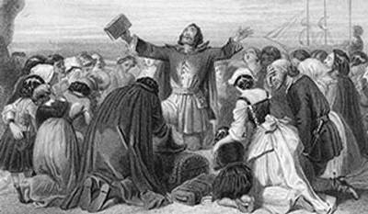
Religion
Basic Beliefs-
Baptists
Presbyterian
Puritan
Quaker

Slide 5
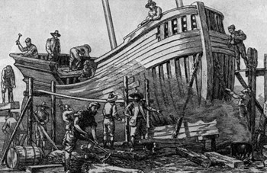
Economy
Concentrated on-
Industries
Farming
Fishing
Ship Building
Fur Trading
Lumbering

Slide 6
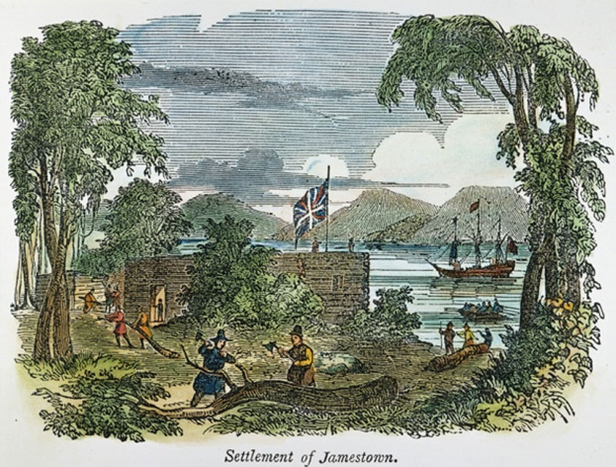
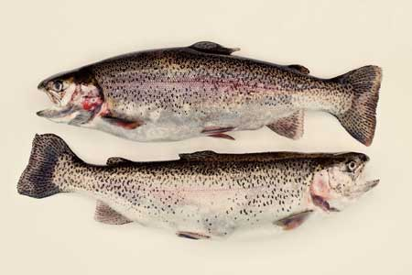
Geography and Natural Resources
Low Coast
Hills
Mountains
Plateau
Fish
Fur
Lumber
Geography
Natural Resources

Slide 7
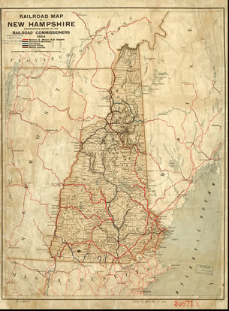
Interesting Facts
New Hampshire- Royal Colony
Founder never stepped foot on New Hampshire
Was given to founder, then named after his home town

Slide 8
Questions
What did you learn?
What are the Natural Resources?
What is one interesting fact?
What is the geography like?

Slide 9
Bibliography
http://anglicanhistory.org/neale/index.html
http://freepages.genealogy.rootsweb.ancestry.com/~mabgenealogy/revwheelwright.html
http://www.endtimepilgrim.org/puritans03.htm
http://colonial-wiki-period-8.wikispaces.com/New+Hampshire
http://teacher.scholastic.com/activities/immigration/tour/stop1.htm
http://www.331fish.com/
http://www.loc.gov/exhibits/macdowell/history/

