Slide 1
Province of Pennsylvania
By: Emily Singpradith and Bella Norton
Notes:
Both: Our colony was Pennsylvania. Pennsylvania was originally called The Provence of Pennsylvania. The word Pennsylvania means “ Penn’s Woods”.

Slide 2
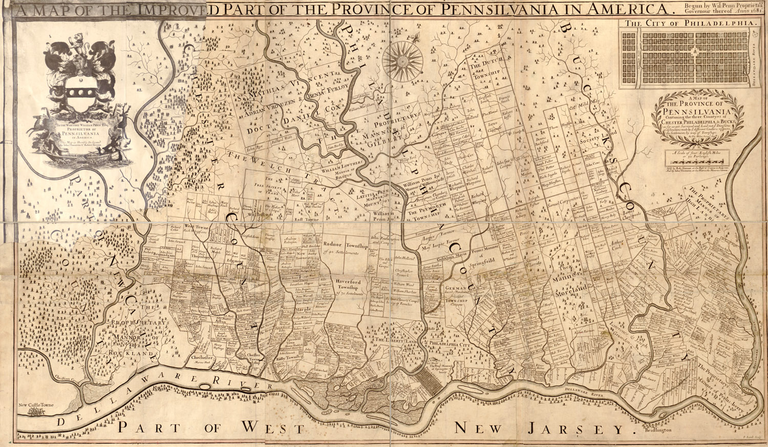
Founding
Founded By: William Penn
Founded: 1682
Reason: So Quakers could worship freely
Notes:
Bella: First, we have the founding.
Emily: Pennsylvania was founded by William Penn.
Bella: It was founded in 1682.
Emily: The reason Penn decided to claim Pennsylvania is so Quakers could worship freely.
Both: The picture above is a colonial map of Pennsylvania

Slide 3
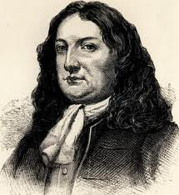
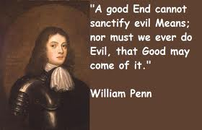
Important People
William Penn
Penn was unique because of his specific beliefs
Notes:
Emily: The most important person is William Penn.
Bella: He is very well known because of his specific Quaker beliefs.
Emily: The picture above on the right is of Mr. William Penn. The picture on the left is one of William Penn’s quotes.

Slide 4
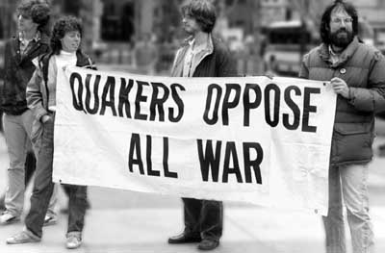
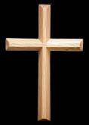
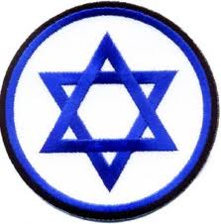
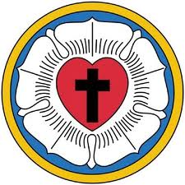
Religion
Quakers
Catholics
No specific religion
Main Religion: Quakers
Quakers believed in peace and no fighting
Pennsylvania gave religious freedom to: Quakers, Lutherans, Catholics, Jews, and others
Jewish
Lutherans
Notes:
Both: Now for religion.
Emily: Pennsylvania has no specific religions.
Bella: Although Pennsylvania doesn’t have a specific religion, it’s main religion is Quaker. Quakers believed in peace and no fighting.
Emily: Pennsylvania gave religious freedom to: Quakers, Lutherans, Catholics, Jews, and others.

Slide 5
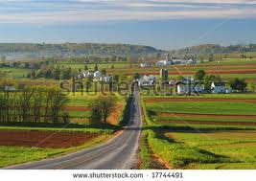
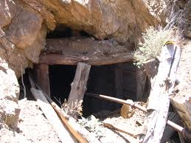
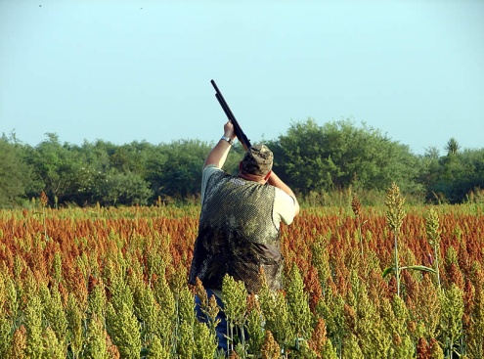
Geography/Climate\Economy
Climate: Warm summers and mild winters
Climate allowed farming
Economy: farming, hunting , and mining
Pennsylvania has a lot of trees, mountains, and farmland.
Notes:
Both: Geography/Climate/Economy.
Bella: Climate: Pennsylvania has warm summers and mild winters. It’s weather allows great farming.
Emily: Economy: Pennsylvania gets it’s money from farming, mining, and hunting.
Bella: This colony has a lot of trees, mountains, and farmland.

Slide 6
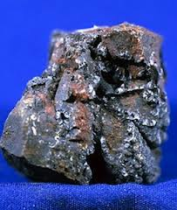
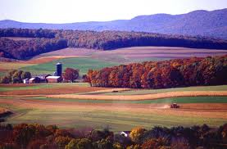
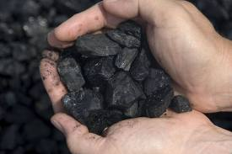
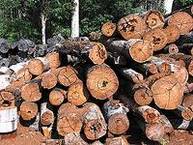
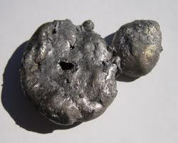
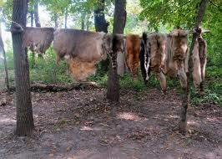
Natural Recourses
Good Farmland
Timber
Furs
Coal
Iron
Ore
Notes:
Emily: Natural Recourses.
Bella: Pennsylvania has many natural recourses.
Emily: Some of them are good farmland, timber, and furs.
Bella: The others are coal, iron, and ore.

Slide 7
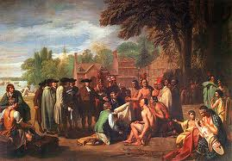
Interesting Facts
Original name of Pennsylvania was Provence of Pennsylvania
The only reason Penn got Pennsylvania was because the king was in debt to his father
Philadelphia was originally the capital of the United States
Notes:
Bella: Interesting Facts.
Emily: Number One: The original name of Pennsylvania is The Province Of Pennsylvania.
Bella: The only reason Penn got Pennsylvania was because the king was in debt to Penn’s father.
Emily: Philadelphia was originally the capital of the United States.
Both: The picture is a colonial picture of Pennsylvania.

Slide 8
What Did You Learn?
Who was the founder of Pennsylvania?
Why was Pennsylvania founded? ( Think about religious freedom.)
What was Pennsylvania’s original name?
What was Pennsylvania’s most famous city, and what is an interesting fact about that city? ( Both answers were in the presentation.)
Notes:
Bella reads the first two questions.
Emily reads the last two questions.
ANSWERS:
William Penn
So Quakers Could Worship freely
Provence Of Pennsylvania
Philadelphia, and for the interesting fact it used to be the capital of the United States

Slide 9
Bibliography
http://www.sonofthesouth.net/revolutionary-war/maps/pennsylvania-map.htm
http://etc.usf.edu/clipart/57700/57730/57730_penn_william.htm
http://www.candler.emory.edu/admissions/blog/category/cannon-chapel/
http://bobswoodcrafts.com/index_039.htm
http://www.thecheapplace.com/blog/jewish-star-patch/
http://www.lutheransonline.com/servlet/lo_ProcServ/dbpage=page&mode=display&gid=20052995655655607101111555&pg=20053040942236960101111555
www.shutterstock.com
http://www.emnrd.state.nm.us/MMD/AML/AML-Hazards.html
http://www.lagovistalodge.com/hunting/
http://www.esri.com/news/arcuser/0402/preserve1of2.html
http://en.wikipedia.org/wiki/Lumber
http://romantichistory.blogspot.com/2011/09/jubilee-colonial-trade-fair.html
http://netrightdaily.com/2012/03/time-to-end-the-war-on-coal/
http://www.amazingrust.com/Experiments/how_to/Thermite.html
http://en.wikipedia.org/wiki/Province_of_Pennsylvania
Notes:
Take turns reading off websites.
Emily goes first.

