Slide 1
The Colony of Rhode Island
By: Ethan Christensen
and Nathan Fitzpatrick

Slide 2
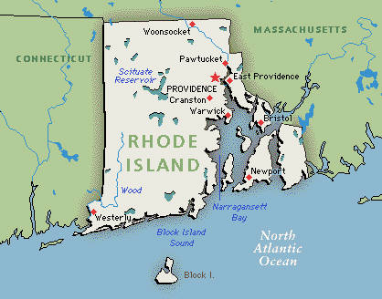
Founded
Founded by Roger Williams.
Found in 1636.
Roger Williams found Rhode island, for freedom, when he was banished from Boston.

Slide 3
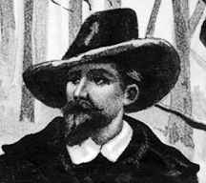
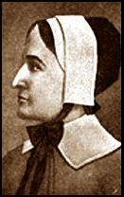
Important People
Roger Williams found Rhode Island and was friendly with the Native Americans.
Anne Hutchinson was free to speak her mind in Rhode Island, she also was the smartest female in Massachusetts.

Slide 4
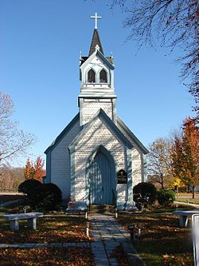
Religion
People have freedom in there beliefs.

Slide 5
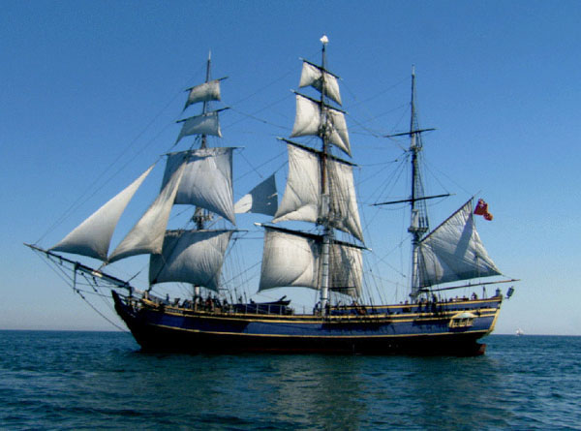
Economy
They would build ships and sell them to other colonies.
The land there was very moist and it was humid.

Slide 6
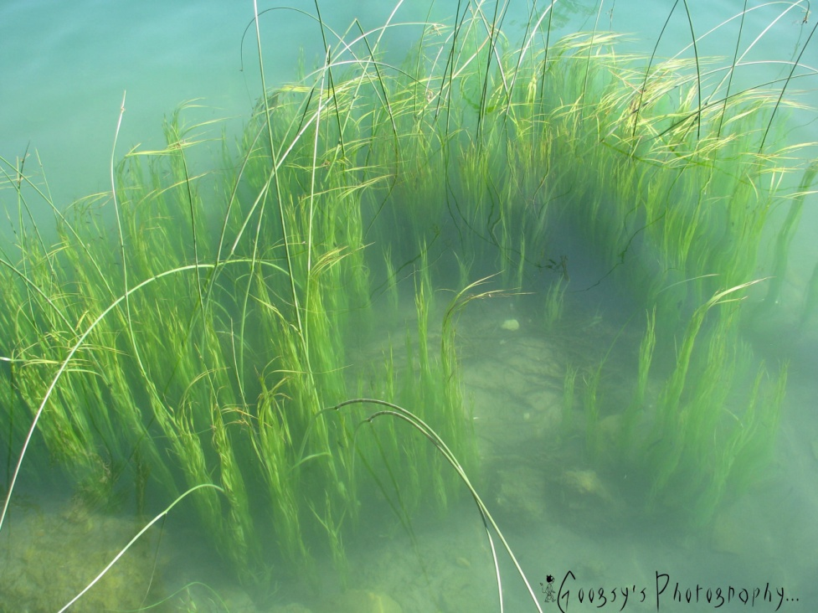
Natural recourses
The ocean near Rhode Island was an advantage.
There are Wales, fish, seaweed, and timber.

Slide 7
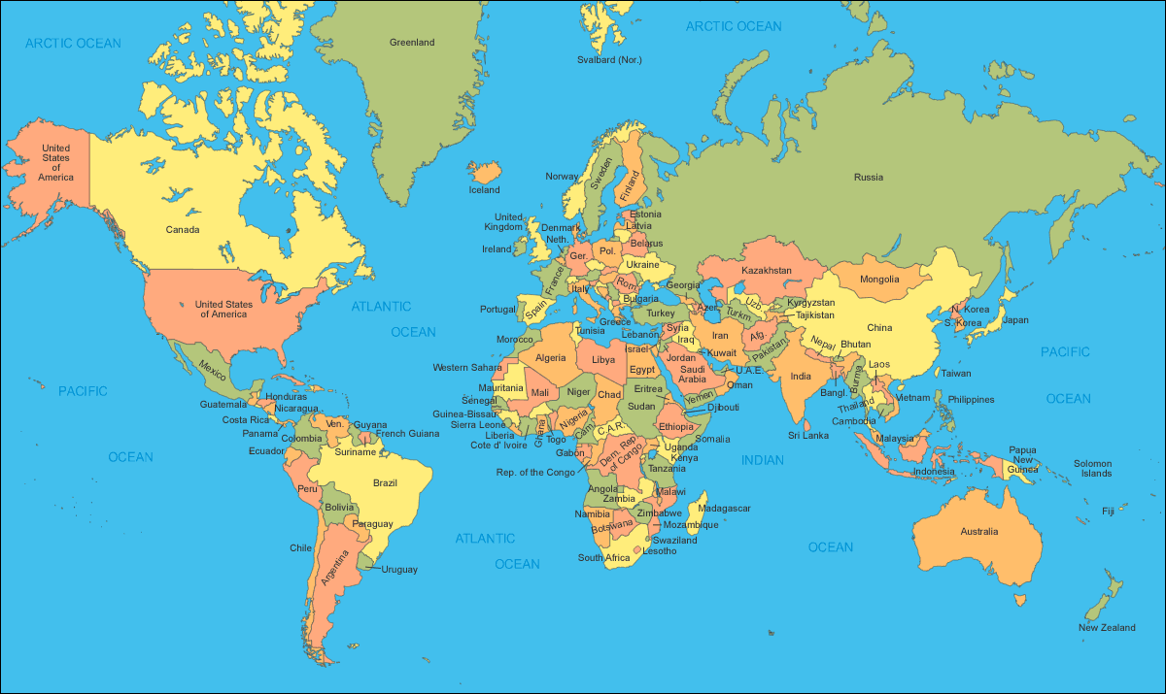
Interesting facts
Rhode Island was is the smallest colony.
People transferred from Massachusetts to Rhode Island.
Before Roger Williams, lots of Native American tribes lived in Rhode Island.

Slide 8
What have you learned
Who found Rhode Island?
What year was Rhode Island found?
Why did Rhode Island have Wales, fish, seaweed?
What was one natural recourse

Slide 9
Bibliography
http://wwp.greenwichmeantime.com/time-zone/usa/rhode-island/map/index.htm
http://www.alomani.com/knowledge/history/us/unit_i_a.html
http://americanphilosophy.net/
http://en.wikipedia.org/wiki/Church_of_the_Holy_Cross_(Middletown,_Rhode_Island)
http://googsy.wordpress.com/2012/02/03/underwater-evolution-of-seaweed/

