Slide 1
The New Hampshire Colony
By: Brenden Lee and Craig Rasku

Slide 2
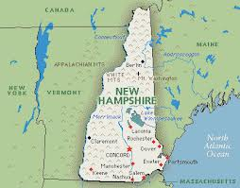
Founded
Founded:1623
Important People: John Mason, John Wheelwright, and Edward Hilton

Slide 3
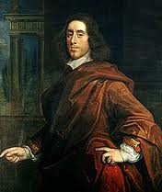
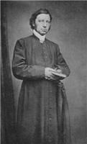
Important people and what they did
John Wheelwright, John Mason, and Edward Hilton founded the colony
John Mason and John Wheelwright founded the Pannaway Plantation

Slide 4
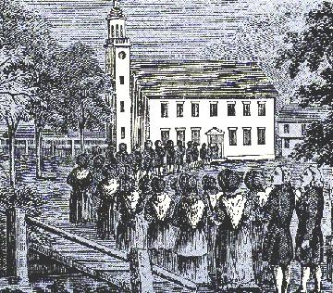
Religon
Religion: Puritan
If you were to miss a day of church you would be severally punished
During service preachers would give powerful sermons

Slide 5
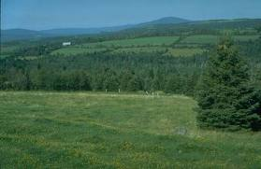
Geography and Climate
Geography: Rocky and covered in trees
Climate: Very cold winters and short mild and warm summers
Less disease than warmer colonies

Slide 6
Natural Resources
Lumber
Whale blubber oil for lanterns
Furs
Farming
Livestock

Slide 7
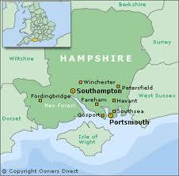
Interesting Facts
Named after: Hampshire England
First settlement pannaway plantation and Hilton’s point
Population in 1775 was 81,050

Slide 8
Bibliography
http://www.xtimeline.com/evt/view.aspx?id=755510
http://www2.maxwell.syr.edu/plegal/tips/t4prod/gelfandwq1.html
http://www.landofthebrave.info/new-hampshire-colony.htm
http://www.kidport.com/reflib/usageography/facts/NewHampshire.htm
http://homeguides.sfgate.com/organic-fertilizers-pine-tree-28036.html

Slide 9
Questions
Who founded New Hampshire?
In what ways did the colonists use the forest in New England?
Why did the English settle in New England?
Why did fishing and whaling become important industries in colonial New England?

