Slide 1
The Pennsylvania Colony
By: Arianna Pierce and Haily Francis

Slide 2
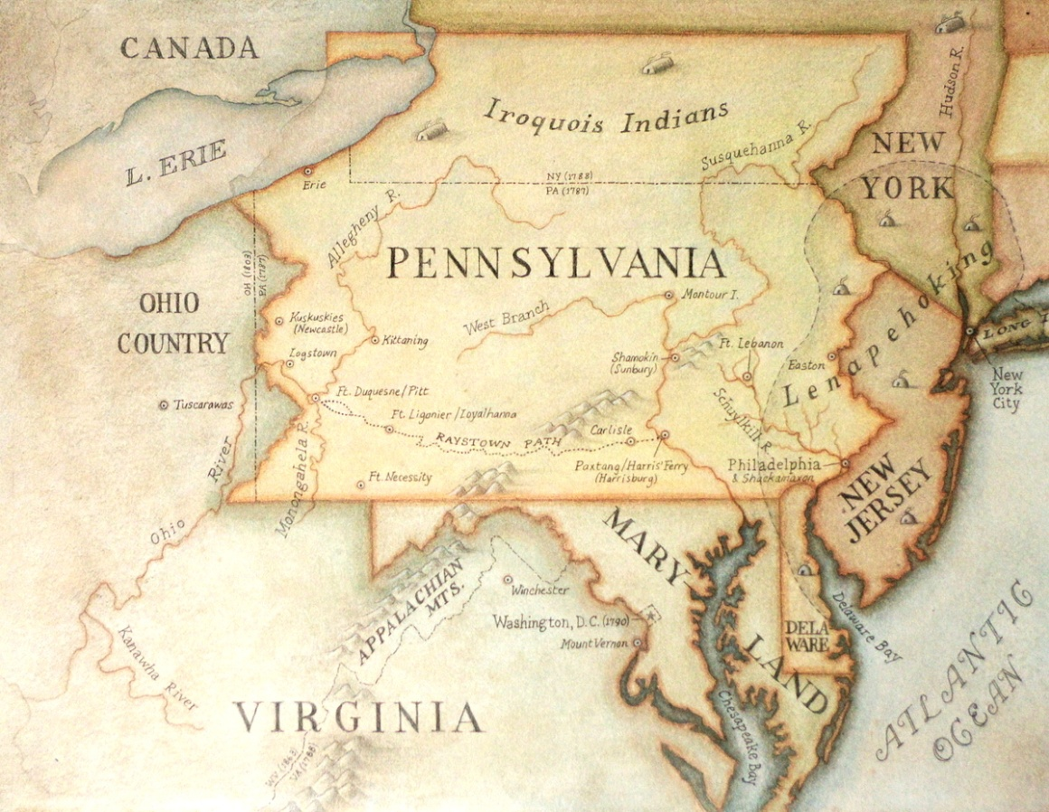
Founded
Founded in: 1643
Leaders: William Penn Found it.
William Penn founded Pennsylvania to be used as a place of refuge for Quakers, but everyone was welcome to live there. At the time, Quakers were being severely persecuted in Great Britain.

Slide 3
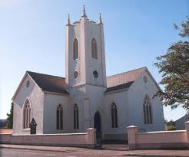
Regional/Basic Beliefs
William Penn belonged to a religious group called “Quakers” they followed the bible’s commandments ( thou shall not kill) so they wouldn’t fight in war 2.

Slide 4
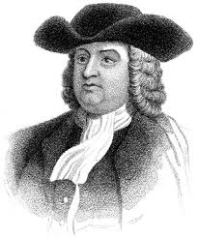
Important People
William Penn is important person.
He let people believe in what they wanted to believe in.
If you don’t know he discovered Pennsylvania.

Slide 5
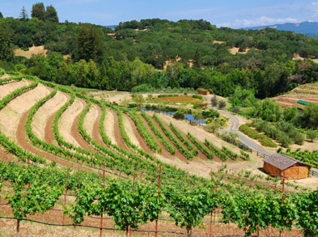
Natural Resources
Some natural resources are river for the food.
Fertile soil also for the food.
They also cut down trees for houses and etc……

Slide 6
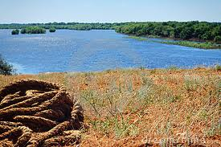
Economy
There Climate was very sunny and sometimes rainy.
Geography: Rivers, They sold left over Surplus Goods to make money

Slide 7
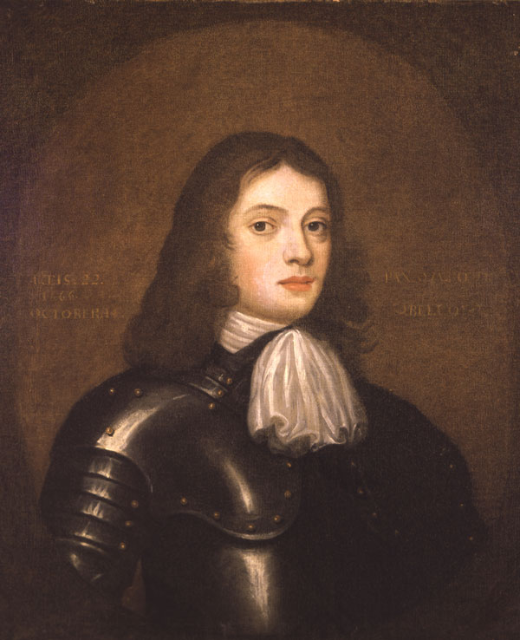
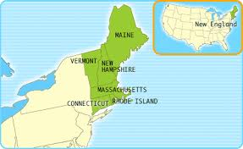
Interesting Facts
William Penn was born In the New England Colony’s.

Slide 8
Questions?????
?
1. Who was the founder of Pennsylvania???
What was our Climate???
What was there Natural Recourse?????
Where was William Penn born???

Slide 9
Bibliography/Web sites
www.tower.com
www.justmytwocopper.org
www.ushistorcy.org
www.drumachose.org
http://hmscourageous.co.uk
www.dreamstime.com
www.google.com/images
http://buttonsandbeadsstoryart.blogspot.com
Clipart

Slide 10
Thanks for Watching Our slide show on our the Pennsylvanian Colony

