Slide 1
Virginia the First Colony
BY: Caleb T. and Jeremiah Johnson

Slide 2
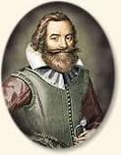
Founder
Founded in 1607
By John Smith & other colonist.
To find gold and riches for the Virginia company

Slide 3
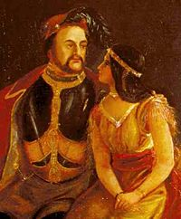
Important people
John Rolfe married Pocahontas witch brought peace to the natives and colonists

Slide 4
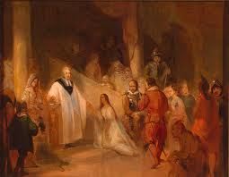
Religion
The colonists were not dominated by specific religions witch gave religious freedom for Baptists.

Slide 5
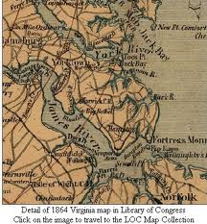
Geography
The Virginia land had many mountains, plains, and valleys

Slide 6
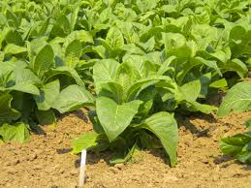
Economy& Natural resources
Tobacco was a major crop for the Virginia colony.

Slide 7
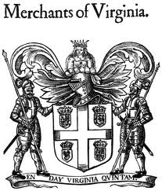
Interesting facts
Virginia became a colony so England could expand there trade and get more goods.

Slide 8
Bibliography
http://www.google.com/search?q=virginia+company&hl=en&safe=active&tbo=d&source=lnms&tbm=isch&sa=X&ei=L0AVUbTiJJDqigKoioDIAg&ved=0CAoQ_AUoAA&biw=1440&bih=719&surl=1
http://www.google.com/search?q=tobacco+crop&rls=com.microsoft:en-us:IE-Address&oe=&surl=1&safe=active&um=1&ie=UTF-8&hl=en&tbm=isch&source=og&sa=N&tab=wi&ei=ekEVUc_jMKaAiwL104HABg&biw=1440&bih=719&sei=f0EVUfjWOOigiQKcnICYBQ
http://www.google.com/search?q=virgina+colony+map&rls=com.microsoft:en-us:IE-Address&oe=&surl=1&safe=active&um=1&ie=UTF-8&hl=en&tbm=isch&source=og&sa=N&tab=wi&ei=E0IVUfubLuHWiwLLzYGgAg&biw=1440&bih=719&sei=FkIVUanMCeWgiALwu4C4BQ
http://www.google.com/search?q=virgina+colony+religion&rls=com.microsoft:en-us:IE-Address&oe=&surl=1&safe=active&um=1&ie=UTF-8&hl=en&tbm=isch&source=og&sa=N&tab=wi&ei=BEMVUYTCBcP1igLbiYGAAw&biw=1440&bih=719&sei=FkMVUeuZA-LniwL67YC4DQ#um=1&hl=en&safe=active&tbo=d&rls=com.microsoft:en-us%3AIE-Address&tbm=isch&sa=1&q=virginia+colony+religion&oq=virgina+colony+religion&gs_l=img.1.0.
0i10i24.43391.46844.2.49437.6.6.0.0.0.0.187.889.1j5.6.0...0.0...1c.1.2.img.KU_DkWENq-U&bav=on.2,or.r_gc.r_pw.r_qf.&bvm=bv.42080656,d.cGE&fp=e8d3bdfadb265275&biw=1440&bih=719http://www.google.com/search?q=johnsmith&hl=en&safe=active&tbo=d&rls=com.microsoft:en-us:IE-
Address&source=lnmhttp://www.google.com/search?q=virginia+colony+geography&hl=en&safe=active&tbo=d&rls=com.microsoft:en-us:IE-Address&source=lnms&tbm=isch&sa=X&ei=ckUVUciXG5DqigKoioDIAg&ved=0CAoQ_AUoAA&biw=1440&bih=719&surl=1s&tbm=isch&sa=X&ei=pEQVUdzUNcm3iwLHxIHQBw&ved=0CAoQ_AUoAA&biw=1440&bih=719&surl=1

Slide 9
QUESTIONS
Who was the founder ?
When was it founded ?
Who was one important person?
What was their cash crop?

